Slide 1
Analytical Paragraph Structure
The foundation of critical thinking in writing

Slide 2
Housekeeping
Last Class
Previewed Essay #2 assignment sheet
Explored Hypothes.is tool
Brainstormed topics for Essay #2
This Week
Finalize Essay #2 Curation topic
Start outlining
Next week
Submit Essay #2
Essay #1 grades returned by ~Feb 28th

Slide 3
Reminders for Topic Approval
Your goal is to curate a list
Your list should include products, tools, apps, or services
not people
Not abstract concepts
not trends
Products et al should be created after 2016, and…
Created by/for generation z

Slide 4
What is Analysis?
Who what when where
summary
writer reports
informative
How and why
claim/argument
narrow focus
connections
apply patterns
writer makes choices

Slide 5
Examples and Resources

Slide 6
Analytical Paragraphs vs. Standard Paragraphs?

Slide 7
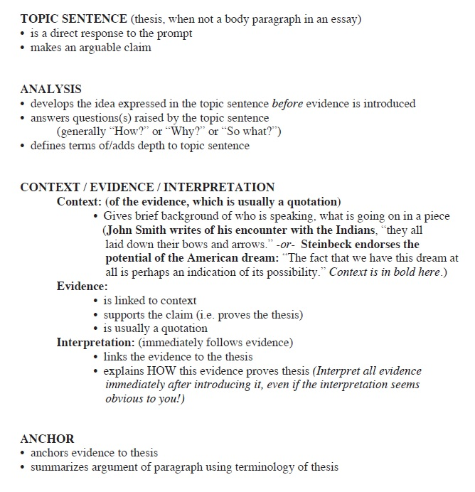
Structure
What’s Familiar?
What’s New?

Slide 8
Breakout Room Practice
Share one person’s paragraph
As a group, highlight each part of the paragraph:
Topic Sentence
Analysis
Context
Evidence
Interpretation
Anchor
Do the sentences connect & make sense?

